Slide 1
Effort Estimation With CrumbScale
Initial estimation and rapid estimation of new items

Slide 2
CrumbScale
2007 Invention (Phillipe Cantin)
2009-2010 First publication (blog)
2017 Description in the Rally-Point Backlog book
2022 Official GitHub
Usages
Multiple domains of application
Small, medium and large development initiatives
Not only used to estimate effort (value, quantity, …)

Slide 3
Effort-points Estimation
Simple
Fast
No re-estimation required
No link between hours and points

Slide 4
CrumbScale
Eliminate hours-vs-points confusion
Remains precise over time
Eliminate the need for re-estimation
Reduce estimation time
Support a robust predictability and planning
Results are accepted by the groupe/team
Bonus creation of rapid estimation tool for estimating future backlog items

Slide 5
Method
2 steps process
No need for special training
Other for the facilitator
Average estimation of 30-60 items per hour
and
Rapid estimation of future backlog items

Slide 6
Estimation CrumbScale

Slide 7
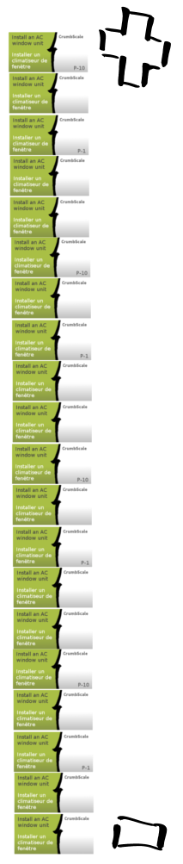
Step 1/2
Sorting by relative size
*via an « insert sort »

Slide 8
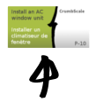
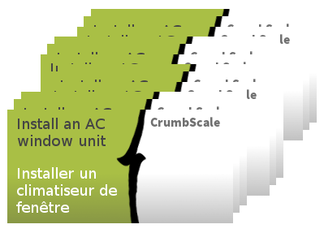
Step 1/2
Insert a first item in the list.

Slide 9
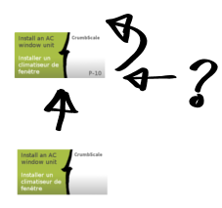
Step 1/2
Insert a second item in the list while asking the question:
‘Is this bigger than…?’

Slide 10
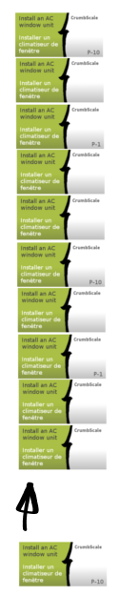
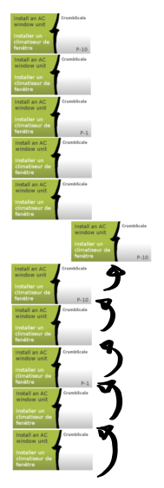
Step 1/2
Always insert from the bottom
Q: ‘Is this bigger than…?’
Correct errors as you go
Repeat for all items. Climb the list while asking the question:
‘Is this bigger than…?’

Slide 11
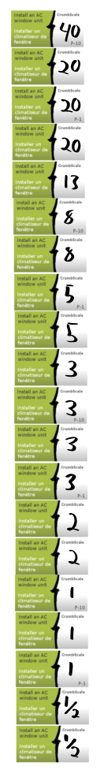
Step 2/2
Points distribution

Slide 12
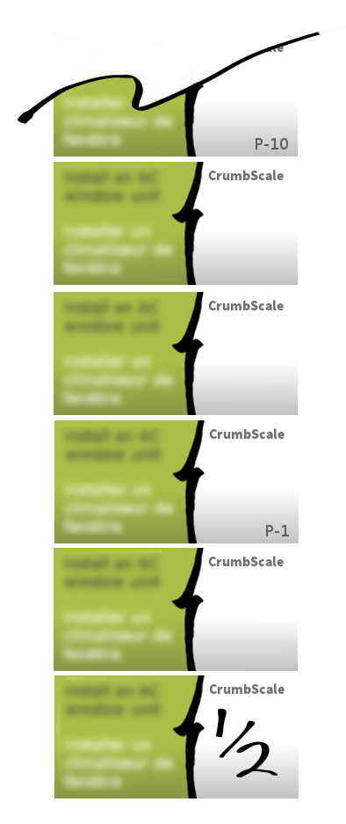

Step 2/2
Identify Crumbs of value ½
(no impact)
Estimation scale
A ‘Crumb’ item has no impact on your daily schedule.
Crumb

Slide 13
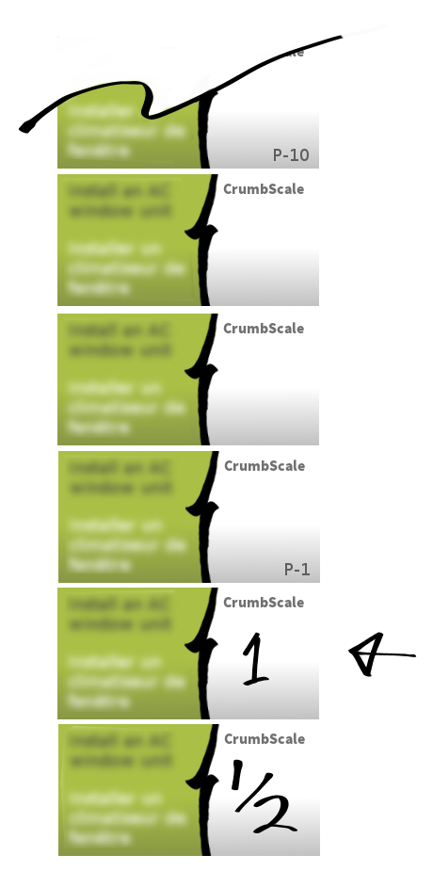
Step 2/2
The first item bigger than a ‘Crumb’, is given the value of 1
­>Crumb

Slide 14
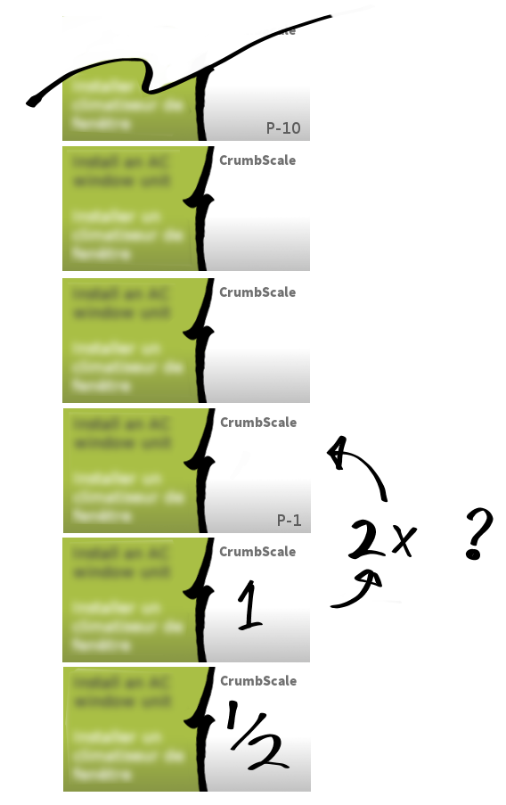
Step 2/2
‘Is this at least 2x bigger than…?’
While going up the list, ask this question:
‘Is the next item at least 2x bigger than this one?’

Slide 15
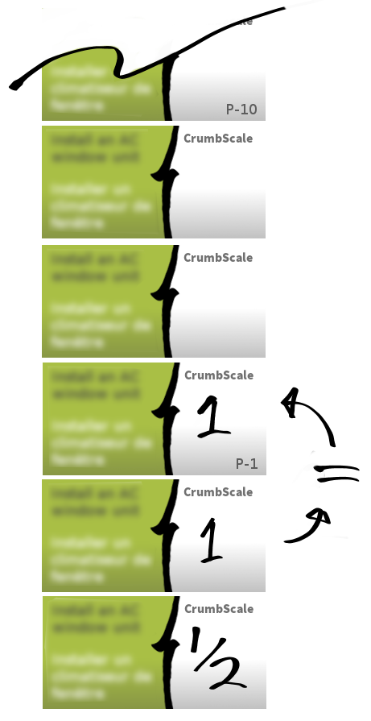
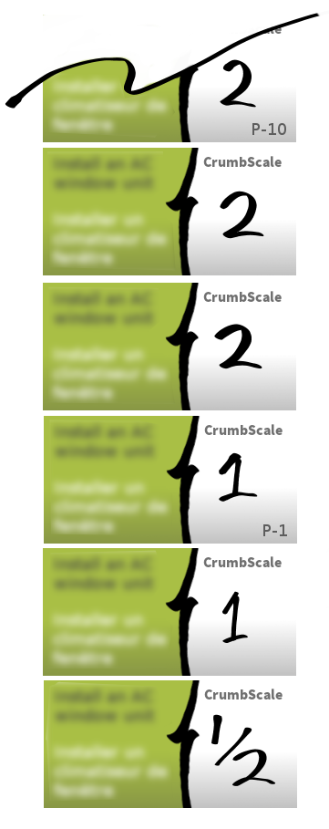
Step 2/2
‘Is this at least 2x bigger than…?’
IF the nest item is not at least 2x bigger, it is assigned the same value. If not we move up to the next value in the estimation scale.

Slide 16
Step 2/2
Identify the ½ (no impact)
Q: ‘Is this 2x bigger than…?’
Correct errors as you go
Go up the list, repeating the same process for each item.
If there is a long series of items with the same value, we do not compare only with the last item but with 2-3 items from the series.

Slide 17
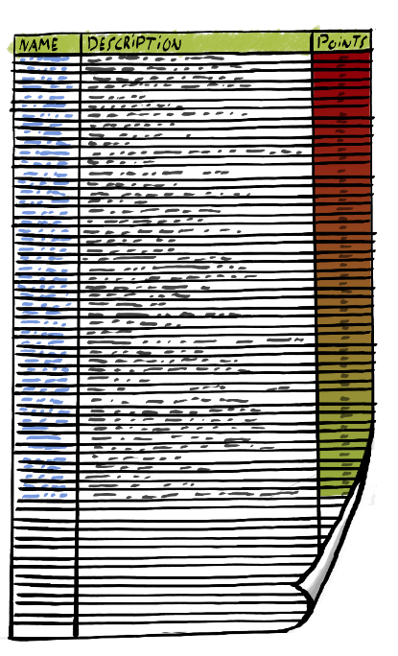
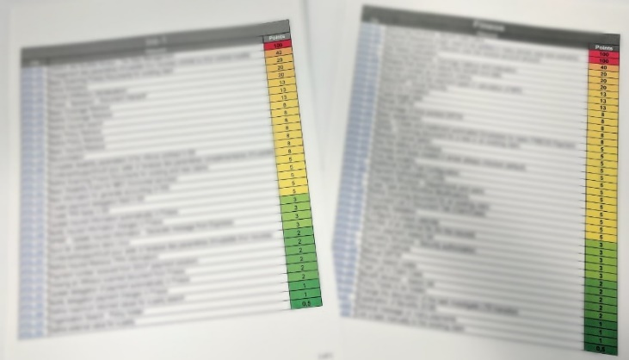
Results
Initial estimation
Rapid estimation tool
No links with hours
Fast
Simple
Create an image or print the tool to avoid the temptation of modifying the values.

Slide 18
Rapid Estimation Tool

Slide 19


Rapid Estimation Tool
Does not change over time
Fundamental to achieve predictability
Enable ultra-fast estimations

Slide 20
Rapid Estimation
After the PO/Arch. has described the new item:
Find similar work in the list
Assign the same value to the new item
With this tool, we do not look for items of the same effort size but items with the same type of work.
Estimating with this tool should take on average 30-60 seconds.

Slide 21

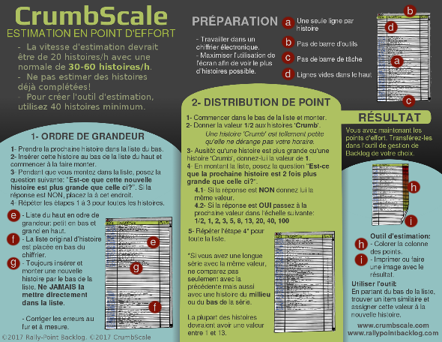

References
https://github.com/pcantin/crumbscale
How To
Troubleshooting
Cheat-Sheets
Rally-Point Backlog
Amazon
Formats: eBook and paperback

